Slide 1
Teensy 3.2 to myRIO
Force Sensor I²C Documentation

Slide 2
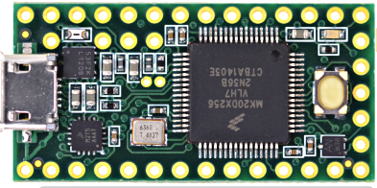
Teensy Connection
SDA
AI3
SCL
AI2
GND
AI1
Vin (+5V)
AI0
+3.3V (Vout)

Slide 3
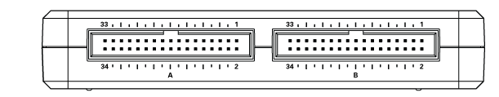
myRIO Connection
+5V (Vout)
GND
SCL
SDA

Slide 4
All Connections.
MyRIO
+5V Vout
SCL
SDA
GND
Teensy
+5V Vin
SCL
SDA
GND
+3.3V Vout
AI0
AI1
AI2
AI3
All HES
GND
+3.3V Vin
HES 1 Vout
HES 2 Vout
HES 3 Vout
HES 4 Vout

Slide 5
Teensy code – Initialisation
#include <Wire.h>
int a = 0; // HES 1 raw voltage reading
int b = 0; // HES 2 raw voltage reading
int c = 0; // HES 3 raw voltage reading
int d = 0; // HES 4 raw voltage reading
volatile byte dataPacket[8]; // array of bytes to send
volatile byte ha = 0; // High byte for HES1
volatile byte la = 10; // low byte for HES1
volatile byte hb = 0; // High byte for HES2
volatile byte lb = 0; // low byte for HES2
volatile byte hc = 11; // High byte for HES3
volatile byte lc = 0; // low byte for HES3
volatile byte hd = 0; // High byte for HES4
volatile byte ld = 13; // low byte for HES4
bytes and byte array declared as volatile, since it is
necessary to inform the compiler that the values may
change via interrupts, so that the compiler
doesn't optimise the code away.

Slide 6
Teensy code – setup function
void setup() {
Wire.begin(1); // join i2c bus with address #1
Wire.onRequest(requestEvent); // register event
}
The event is processed as an interrupt, which is why the bytes were
Declared as volatile.

Slide 7
Teensy code – main loop function
void loop() {
a = analogRead(0); //read raw bits for HES 1
b = analogRead(1); //read raw bits for HES 2
c = analogRead(2); //read raw bits for HES 3
d = analogRead(3); //read raw bits for HES 4
getByte(); // cast to high and low bytes
fillArray(); // build byte array for transfer
delay(1);
}
These 2 functions build the array ready for transfer

Slide 8
Teensy code – getByte() function
void getByte() {
ha = highByte(a);
la = lowByte(a);
hb = highByte(b);
lb = lowByte(b);
hc = highByte(c);
lc = lowByte(c);
hd = highByte(d);
ld = lowByte(d);
}
This function casts the data for each sensor into a high byte, and a low
Byte. This is necessary because the data is greater than 255, or longer than 1 byte
Eg, 566 dec = 0000001000110110 bin
0000001000110110
00000010
00110110
High byte
low byte

Slide 9
Teensy code – fillArray() function
void fillArray() {
dataPacket[0] = ha;
dataPacket[1] = la;
dataPacket[2] = hb;
dataPacket[3] = lb;
dataPacket[4] = hc;
dataPacket[5] = lc;
dataPacket[6] = hd;
dataPacket[7] = ld;
}
This function builds the 8-byte array
00000010
00110110
00000010
00110110
00000010
00110110
00000010
00110110
High byte a
low byte a
High byte b
low byte b
High byte c
low byte c
High byte b
low byte d

Slide 10
Teensy code – I2C Event function
void requestEvent() {
Wire.write((byte*)dataPacket, 8);
}
This function fires when the myRIO (I2C Master) sends a request
For data.
The array of 8 bytes (the data packet) is written to the data line

Slide 11
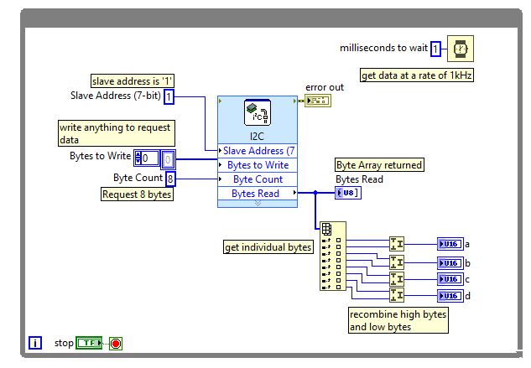
myRIO code

